Slide 2
Reporting
Microsoft Project 2010 Ignite

Slide 3
Agenda
Introduction
Infrastructure
Data
Excel Services
Performance Point Services
Visio Services
Power Pivot (part of SQL Server 2008 R2) and SQL Reporting Services

Slide 4
Reporting - Part 1
Microsoft Project 2010 Ignite

Slide 5
Introduction

Slide 6
Business Intelligence (BI) in 2010 driven by customer feedback
Project Server 2003
Limited reporting relying on OLAP Databases
Project Server 2007
Significant enhancements in the reporting infrastracture
Hard to build comprehensive dashboards using out-of-box functionality
Relying on “legacy” Office Web Components (OWC) ActiveX components
Project Server 2010
Leveraging the architecture of Project Server 2007
Building on the powerful collaboration and BI platform of SharePoint 2010 w/ Enterprise CAL

Slide 7
Expectations (1/3) What hasn’t changed for 2010
Same underlying database structure
Relational
OLAP
Data flow is the same
Leverage queue for reporting publish jobs

Slide 8
Expectations (2/3) What’s changed for 2010?
Infrastructure
No Office Web Components
Data Analysis views are not upgraded
Not integrated with Views Management
Built on SharePoint BI Technologies
New BI Center site
Out of the box integration with Excel Services
3 tier architecture

Slide 9
Expectations (3/3) What’s changed for 2010?
Data
New Data and Views in Reporting DB
New entities in the Reporting DB
Multiple OLAP Database support
Portfolio and Project data together

Slide 10



Microsoft Business Intelligence Tool Segmentation
Personal BI
“My Ad-Hoc Needs”
Department BI
“My Group’s Needs”
Enterprise BI
“My Company’s Needs”
Project Visual Reports
SQL Server Reporting Services
Performance Point Services
Excel Services
Visio Services
SQL Server 2008 R2 PowerPivot
Notes:
Describe three segments
Talk about who, what this means
Structure, scale, skill needed to address needs for each segment rise as you move to the right
The first four tools existed for 2007, the last two have been delivered with 2010.
As you can see, we have a number of tools for every need.
So, the question became what tool do people want to use primarily for reporting and analysis?

Slide 11
Related Resources
WebCasts (http://www.microsoft.com/events/series/epm.aspx)
Project 2010 Business Intelligence Center
http://go.microsoft.com/?linkid=9726143
Accessible from Project Server 2010 TechCenter site http://technet.microsoft.com/projectserver/
SharePoint 2010 Business Intelligence Center
http://technet.microsoft.com/sharepoint/ee692578.aspx

Slide 12
Infrastructure

Slide 13
Business Intelligence Center
A sub-site of the Project Web App site
Same security permissions as PWA site
Inheritance may be disabled so that Report Center security may be managed manually
Hybrid mode – you can grant additional permissions

Slide 14
Out Of the Box Reports
Sample Reports | Templates
Deliverables | DependentProjects
IssuesAndRisks | Issues
MilestonesDueThisMonth | ProjectsAndAssignments
RejectedProjectList | ProjectsAndTasks
ResourceCapacity | Resources
SimpleProjectList | Risks
TimesheetActuals | Timesheet
TopProjects
WorkflowChart
WorkflowDrillDown

Slide 15
Out Of the Box Data Connections and Cubes
Reporting Database (RDB) - Office Data Connection Files | Analytical Database (OLAP) - Cubes
Project Server - Project Assignment Data | Assignment Non Timephased
Project Server - Deliverables | Assignment Timephased
Project Server - Issue Data | Deliverables
Project Server - Project And Task Data | EPM Timesheet
Project Server - Rejected Projects List | Issues
Project Server - Resource Capacity | MSP_Portfolio_Analyzer
Project Server – Resource Data | MSP_Project_SharePoint
Project Server - Risk Data | MSP_Project_Timesheet
Project Server - Simple Projects List | Project Non Timephased
Project Server - Timesheet Data | Resource Non Timephased
Project Server - Top Projects Data | Resource Timephased
Project Server - Workflow Chart Data | Risks
Project Server - Workflow Drilldown Data | Task Non Timephased
 | Timesheet

Slide 16
Business Intelligence Center Consideration for customization
Renaming or deleting default content and folders is not recommended
Microsoft updates ( service packs and patches ) may update and/or recreate default content/folders

Slide 17
Business Intelligence Center OLAP Integration
When OLAP Database is created, the following is created in the Reports folder:
Office Data Connection
Excel Reporting templates are created
This data connected blank template will help you to quickly create new reports based on the new OLAP Database

Slide 18
DEMO
SharePoint BI Center

Slide 19
DATA

Slide 20
Reporting database enhancements
With the integration of Project Portfolio Server functionality into Project Server 2010 in this release, Portfolio data elements were added to the Reporting Database
Portfolio Data Tables
MSP_EPMENTERPRISEPROJECTTYPE
MSP_EPMOPTIMIZERDECISIONTYPE
MSP_EPMPLANNERDECISIONTYPE
MSP_EPMPROJECTCOMMIT
MSP_EPMWORKFLOWPHASE
MSP_EPMWORKFLOWSTAGE
MSP_EPMWORKFLOWSTATUSINFORMATION
MSP_EPMWORKFLOWSTATUSTYPE
Notes:
RDB = Reporting Database
Portfolio Data
With the integration of Project Portfolio Server functionality into Project Server 2010 in this release, Portfolio data elements were added to the Reporting Database. These data elements include:
Workflow
Drivers
Commit Table Entries
Project Impact Values
Driver Prioritizations
Planner Requirements By Role
Planner Capacity By Role
Planner Rates By Role

Slide 21



The Progression of Analytic Data
 | Project 2003 | Project 2007 | Project 2010
OLAP Analysis Databases | 1 | 1 | Many
Cubes within the Analysis Database | 3 | 14 | 14

Slide 22
Multiple OLAP Databases Overview
Breaks down the EPM cube build process into different chunks
Departmental filtering
More Admin control
Departmental filtering of cubes
Control over intrinsic (out-of-the-box) fields included in cube builds
Multi-Language Support
Based on the Language Packs installed

Slide 23
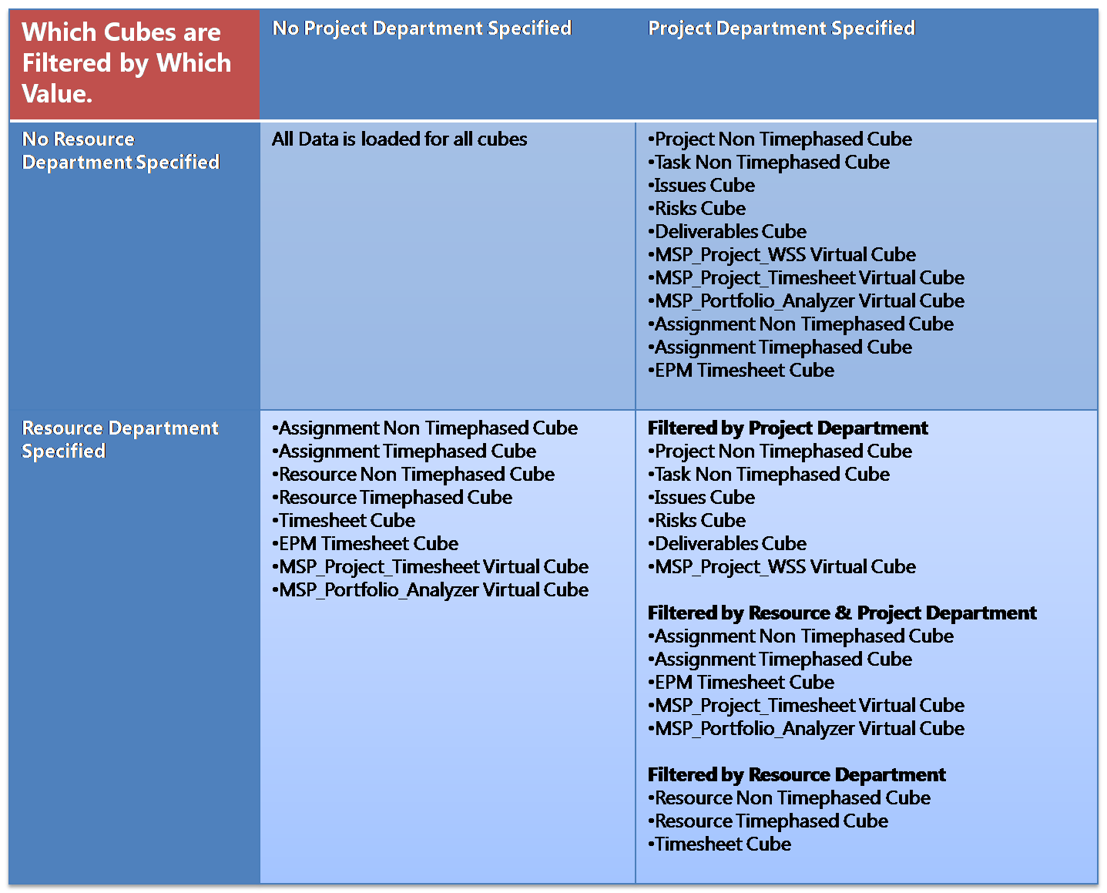
Departments and OLAP
Notes:
The subset of projects and resources will be used to filter at the project and timesheet level as follows:
Project Non Timephased:
The data in this cube will be filtered by the departmental project list.
Projects with assignments to the department’s resources will be included.
Task Non Timephased
Non-departmental tasks with assignments to the department’s resources will be included.
Note, the full non-departmental project will not be included.
All tasks for departmental projects will be included.
Assignment Non Timephased
Non-departmental project assignments for the department’s resources will be included.
All assignments for departmental projects will be included.
Assignment Timephased
Non-departmental project assignments for the department’s resources will be included.
All assignments for departmental projects will be included.
Deliverables
All deliverables owned by the filtered list of projects
All deliverables to which the filtered list subscribe and the projects/tasks that subscribe to the filtered list’s deliverables.
All deliverables offered by non-departmental projects that are subscribed to by departmental projects.
Issues
Issues connected to the filtered list of projects and tasks.
Risks
Risks connected to the filtered list of projects and tasks.
Resource Non Timephased
Resources in the departmental list
Resource Timephased
Resources in the departmental list
Timesheet
Timesheets for departmental list resources.
EPM Timesheet
Timesheets for departmental list resources.
Task assignments from projects outside of the department will also be included.
Notes on Resources in a Department filtered OLAP database:
Resources are described in three ways in the OLAP Databases:
Fact focus (timesheets, capacity)
Associated with Facts (project task assignments)
Owning Facts (project owner, issue owner, assignment owner)
The departmental resource list is used to filter facts with focus (Timesheets). Consequently, a non-departmental resource will never have any timesheets or capacity in the OLAP Database if the database has a resource filter. However the non-departmental resource will be in the Resource List dimension if it has association with a departmental project, and will only have the relevant assignment facts.
Resources who own things have separate dimensions (i. e. Assignment Owner) need not be in the resource list.
So the Resource List dimension for a specific OLAP Database contains:
The departmental resources
All resources with assignments to departmental projects

Slide 24
DEMO
Multi OLAP Databases

Slide 25
Excel Services

Slide 26
Benefits of Excel Services
Easy sharing of data both inside and outside your corporate environment
Reports presented via web interface
Wide availability authoring tool
Office Excel 2007 or Excel 2010 client
Most IW Report Authors are familiar with core Excel functionality (Pivot Tables/Charts)
Notes:
Facilitates easy sharing of data both inside and outside your corporate environment
It enables Personal BI and Team BI scenarios of the BI continuum
These scenarios focus on enabling users to serve their own Business Intelligence needs
Data can be shared via web interface using Excel Services
Data can be distributed via XLSX files via email or some other facility and using Excel client for viewing
Files can be static snapshots of the web view, allowing you to share broadly or to modify the data for your own uses
Files can also remain data connected, allowing the user to refresh the data as needed, using the client. Note, this functionality requires IW Report Author level security.
Wide availability of requisite authoring client
This experience requires the Office Excel 2007 or Excel 2010 client.
Most IW Report Authors are already familiar with core Excel functionality (Pivot Tables/Charts)

Slide 27
Excel Services - Other Key Facts
Custom fields won’t show up automatically
Need to be added manually to RDB ODCs
Tradeoff between localization and custom fields
We will have more documentation on this
Localized report templates are created in separate folders
One for each language
Departments filter OLAP but not RDB out of box

Slide 28


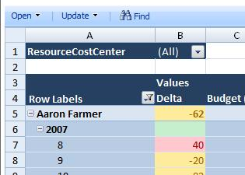


Configure Excel Services and Secure Store Configure Relational and Analysis DB access
Project Web App -> Business Intelligence Center
Excel Workbook
Excel
Services
Secure Store
Application Profiles
Office Data Connection
Database Server
Reporting
DB
Analysis
DB

Slide 29
Reporting Security Model
Reporting Security
User Access
Document Access
Data Access
What Can the User Do?
Author
Viewer
Administrator
What Data Can They Access?
Secure Store Profile
SQL Rights
What Content Can They Access?
Data Connections
Excel Document

Slide 30
DEMO
Excel Services

Slide 31
Related Resources
WebCasts (http://www.microsoft.com/events/series/epm.aspx)
TechNet Webcast: Project Server 2010 Project and Portfolio Management Reporting (Level 200) by Marc Soester, Project MVP
MSDN Webcast: Project 2010 BI & Portfolio Reporting - Part 1 and 2, by Marc Soester, Project MVP
MSDN Webcast: Real-World Solutions: Project Server Security in SQL Server Reporting Services (Level 300) by Stephen C. Sanderlin, Project MVP
Project 2010 Business Intelligence Center
http://go.microsoft.com/?linkid=9726143
Accessible from Project Server 2010 TechCenter site http://technet.microsoft.com/projectserver/

Slide 32

- Resources
Product information and trial download
http://www.microsoft.com/project
Project Team Blog http://blogs.msdn.com/project
Interactive content - Videos & Sessions & Webcasts
http://www.microsoft.com/showcase/en/US/channels/microsoftproject
http://www.microsoft.com/events/series/epm.aspx
IT Professional related
TechCenter @ TechNet http://technet.microsoft.com/ProjectServer
Admin Blog http://blogs.technet.com/projectadministration
Developer related
Developer center @ MSDN http://msdn.microsoft.com/Project
Programmability blog http://blogs.msdn.com/project_programmability
Additional questions? Project 2010 Forums!
http://social.msdn.microsoft.com/Forums/en-US/category/projectserver2010,projectprofessional2010
SharePoint 2010
http://sharepoint.microsoft.com
FORUMS
Project Professional 2010
General Questions and Answers
Project Server 2010
General Questions and Answers
Setup, Upgrade, Administration and Operation
Customization and Programming

Slide 33
Summary for Part 1
Introduction
Infrastructure
Data
Excel Services

Slide 34

© 2009 Microsoft Corporation. All rights reserved. Microsoft, Windows, Windows Vista and other product names are or may be registered trademarks and/or trademarks in the U.S. and/or other countries.
The information herein is for informational purposes only and represents the current view of Microsoft Corporation as of the date of this presentation. Because Microsoft must respond to changing market conditions, it should not be interpreted to be a commitment on the part of Microsoft, and Microsoft cannot guarantee the accuracy of any information provided after the date of this presentation. MICROSOFT MAKES NO WARRANTIES, EXPRESS, IMPLIED OR STATUTORY, AS TO THE INFORMATION IN THIS PRESENTATION.

